Slide 1
Board of directors Meeting
February 3, 2021

Slide 2
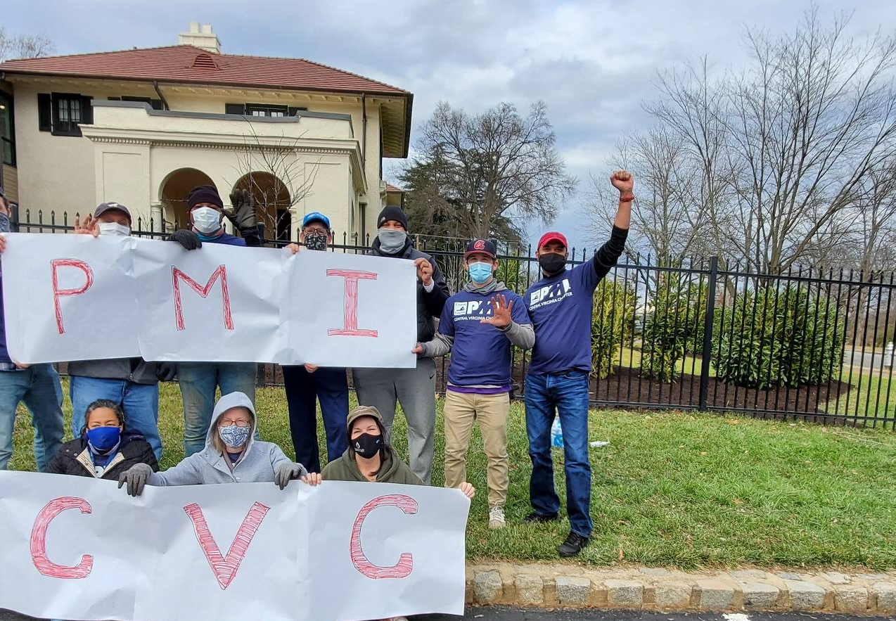
MayMont
January 18,2021
CVC Mission
To serve the professional interests of chapter members by enhancing expertise through project management education and training, supporting PMI certifications, and promoting association with other project management professionals.
Notes:
Check website single sign on
Suresh motion to start the meeting/Joyce 2nd

Slide 3
BOARD OF DIRECTORS AND OTHER ATTENDEES
President -Ron Younger | P | VP Communication – Jonette Meade
Executive VP – Suresh Raju | P | VP Operations - Vacant
VP Education – Vacant |  | VP Finance – Joyce Glady | P
Speakers – Kerrie Arkwell |  | Secretary – Kelly Evans | P
Charlottesville – Susan Thomas | P | Financial Oversight – Ed Foster
Registration Operations – Bob Ramos | P | Toastmasters – Andrey Karpov
FLiPM – Jennifer Romero Greene |  | Volunteerism – Abhi Thakar
Membership – Jason Plotkin |  | Strategy – Danielle Dodge | P
Military Liaison – Devin Klinewell |  | PMIEF Coordinator- Brett Sheffiled
Fredericksburg – Greg Chambers |  | Technology – Vacant
Newsletter – Lavanya |  | Social Media – Vacant
Sponsorship – Vacant |  | Event Planning – Vacant
Attendee – Dana Newcomer | P | Attendee – Chris Baber | P
Teresa Younger Director of Programs | P | Attendee -

Slide 4
Table of Contents
Open Meeting
Volunteer Appreciation
Org Changes
Budget
Prof Dev Day/Week
25th Anniversary
Review & Approve Prior BoD Meeting Minutes
Agenda
Review Core Services
Approve Agenda
Motion
Motion
Motion
Notes:
Suresh made motion to approve prior meeting minutes/ Ron Second
Joyce motion to approve the agenda, Suresh second

Slide 5
Table of Contents
Volunteer Appreciation
Motion
Motion
Motion
Org Changes
Motion
Motion
Budget
Prof Dev Day/Week
25th Anniversary
Review Core Services
Notes:
Gilbert and Dave stepped down. Danielle took on the role of military liaison. Changed name to Military Outreach spoke to our chapter partner at PMI to confirm this was ok. PMIEF liaison name will change Brett Sheffield will stay on. Professional development changed to director of programs. Teresa Younger will take this new role. Joyce gave an update on current state of the budget. Spoke to cps to use their service for the PDD. Looking at end of Oct. or Nov. recruiting a project manager to manage this effort. Goal is to break even or make money. We are in the 25th year, may want to postpone until we can meet in person. Joyce, Suresh and Ron agreed. Will send out notice to members. Volunteer recognition – board approved meals.
AI – Kelly to connect Ron with international chapters
AI – vote on MBL and Bill board to see what will go into the budget
AI – Ron going to change agenda/minutes to old format and keep the core services section
Joyce made motion to close the meeting/Suresh second

Slide 6
CHAPTER EVENTS Chapter Meetings (face-to-face or virtual - including webinars, live streaming etc.) Weekly, Bi-Weekly, Monthly or Quarterly meetings; Evening or Dinner Meetings; Breakfast Meetings; Lunch Sessions etc. either in person, or via digital means to host meetings with members
Annual Goal
Edu – No meetings
January KPIs
Edu -10 Live Virtual or Richmond Chapter Meetings
Edu -10 Live Virtual Innovation Professional Group meetings
Edu - 8 Live Virtual Toastmasters Meetings
VP Ops - Summary of face-to-face meetings where a virtual option can be leveraged, for Board approval, target due date March 2021
February Goals
Edu -1 Live Virtual Meetings
Edu -1 Live Virtual Innovation meetings
Edu - 2 Live Virtual Toastmasters Meetings

Slide 7
CHAPTER EVENTS Networking events (included as part of Chapter Events) Social events; non-project management sessions; no-PDU sessions; pre or post monthly meeting; get together sessions; coffee breakouts; meet ups etc.
Annual Goal
20 Virtual Networking Pre-Meeting
January KPIs
Edu – No meetings
February Goals
Edu -1 Live Virtual Meetings
Edu -1 Live Virtual Innovation meetings
Edu - 2 Live Virtual Toastmasters Meetings

Slide 8
CHAPTER EVENTS Work with other chapters to address regional initiatives As necessary, deal with regional members issues across multiple chapters within the region
Annual Goal
Edu/Ops – Plan and host multi-chapter/regional initiatives
January KPIs
Edu – No meetings
February Goals
Edu -1 Live Virtual Meetings
Edu -1 Live Virtual Innovation meetings
Edu - 2 Live Virtual Toastmasters Meetings

Slide 9
CHAPTER EVENTS (NEW) Social Good Projects or Events Chapter's initiatives should be based on the United Nations (UN) Sustainable Development Goals (SDG) that all were championing at PMI's 50th Anniversary celebrations. Chapters are encouraged to continue this important activity working independently or collaboratively with other chapters to provide the much needed social good projects within their communities.
Annual Goal
EDU/PMIEF - Plan and host social good event/project
January KPIs
Edu – No meetings
February Goals
Edu -1 Live Virtual Meetings
Edu -1 Live Virtual Innovation meetings
Edu - 2 Live Virtual Toastmasters Meetings

Slide 10
CAREER DEVELOPMENT Professional or Career development events (Professional Development Days; Project Management conferences, forums or symposiums - in person or virtual) Events designed specifically to deal with career development - educational sessions - may include risk, scheduling, change, people management etc. Could be half-day, one-day, or multi-day multi-learning and sharing sessions; guest speakers; keynote speakers; trainers; facilitated panels etc.
Annual Goal
Professional Development Day/Week Fall 2021
January KPIs
Edu – No meetings
February Goals
Edu -1 Live Virtual Meetings
Edu -1 Live Virtual Innovation meetings
Edu - 2 Live Virtual Toastmasters Meetings

Slide 11
CAREER DEVELOPMENT PMI credentials examination preparation course offerings (Offered direct or through Training Partners) Whether in-house or partner offering - help members prepare for the PMP exam as well as, if possible other certifications
Annual Goal
EDU - Partner with Agile Training Partner (ATP) for Agile Training PMI Certification prep course
January KPIs
Edu – No meetings
February Goals
Edu -1 Live Virtual Meetings
Edu -1 Live Virtual Innovation meetings
Edu - 2 Live Virtual Toastmasters Meetings

Slide 12
CAREER DEVELOPMENT Project Management educational or training Sessions (Disciplined Agile; Risk Management; Scheduling; Software Tools and much more) Sessions developed by the chapter or engaged/contracted via REPs or volunteers designed to meet the needs of the members
Annual Goal
2 Technical Project Management (MS Project Or PM Tool)
2 Agile training (Scrum, DADM)
January KPIs
Edu – No meetings
February Goals
Edu -1 Live Virtual Meetings
Edu -1 Live Virtual Innovation meetings
Edu - 2 Live Virtual Toastmasters Meetings

Slide 13
MEMBER COMMUNICATION Communications with Members (Welcome Letters, Confirmations, Acknowledgements, Renewal letter and others) Members need to know they are valued, chapters must communicate with their members using any or all of the many options open to them - whether to welcome them, update them on changes, congratulate their success, thank them for volunteering and much more
Annual Goal
VP Comms: Enhance newsletters based on data and have these letters automated to members and returning members
January KPIs
Edu – No meetings
February Goals
Edu -1 Live Virtual Meetings
Edu -1 Live Virtual Innovation meetings
Edu - 2 Live Virtual Toastmasters Meetings
VP Ops: Website with Contact Details, Roles & Responsibilities, Monthly Board Meeting Minutes, Newsletters and Calendar of Events

Slide 14
MEMBER COMMUNICATION Member recognition. New members, PMI credentialed recognition - Volunteer recognition and Awards Key to being part of the chapter - assign ambassadors to welcome new attendees, highlight all new members, special invites for orientation with board members, etc. Never miss an opportunity to let the member know they are part of this community. Make sure the volunteers are acknowledged and recognized for their contributions, and if appropriate and feasible, provide awards for them, maybe a "thank you" appreciation event.
Annual Goal
Comms: Send letters to new members and new credential holders and recognize them during meetings, as well as on all of our social meeting platforms, in the newsletters
January KPIs
Edu – No meetings
February Goals
Edu -1 Live Virtual Meetings
Edu -1 Live Virtual Innovation meetings
Edu - 2 Live Virtual Toastmasters Meetings

Slide 15
MEMBER COMMUNICATION Website (Standard minimum operational information) Must be have a base website with contact details, calendar of events etc.
Annual Goal
Comms: Enhance Website with Contact Details, Roles & Responsibilities, Monthly Board Meeting Minutes, Newsletters and Calendar of Events
January KPIs
Edu – No meetings
February Goals
Edu -1 Live Virtual Meetings
Edu -1 Live Virtual Innovation meetings
Edu - 2 Live Virtual Toastmasters Meetings

Slide 16
MEMBER COMMUNICATION Targeted Marketing (to member segments) Examples could include Newsletters for the PM Pro and a different type of communication for the next Gen PM. These would focused communications on specific topics or activity - could include Social Good activities, job fairs, training opportunities, volunteer openings etc.
Annual Goal
VP Comms: Target Charlottesvile market
January KPIs
Edu – No meetings
February Goals
Edu -1 Live Virtual Meetings
Edu -1 Live Virtual Innovation meetings
Edu - 2 Live Virtual Toastmasters Meetings
VP Ops - Create a Slack channel or other non-email option

Slide 17
MEMBER COMMUNICATION Social Media (LinkedIn, Facebook, Twitter, others) Chapters may opt to use these for communication to members, need to make sure there is a person or group who manages the social media
Annual Goal
VP Comms: Review and update Social Media strategy.
January KPIs
Edu – No meetings
February Goals
Edu -1 Live Virtual Meetings
Edu -1 Live Virtual Innovation meetings
Edu - 2 Live Virtual Toastmasters Meetings
VP Ops - Videos of past events, Newsletters; Articles

Slide 18
MEMBER COMMUNICATION Focus groups or Forums Optional way for members to communicate with the chapter leaders
Annual Goal
Edu -10 Live Virtual or Richmond Chapter Meetings
Edu -10 Live Virtual Innovation Professional Group meetings
Edu - 8 Live Virtual Toastmasters Meetings
VP Ops - Summary of face-to-face meetings where a virtual option can be leveraged, for Board approval, target due date March 2021
January KPIs
Edu – No meetings
February Goals
Edu -1 Live Virtual Meetings
Edu -1 Live Virtual Innovation meetings
Edu - 2 Live Virtual Toastmasters Meetings

Slide 19
MEMBER COMMUNICATION Website (Enhanced) Adding more options to the standard website - videos of past events, copies of webinars or podcasts, articles, blogs, news letters and more.
Annual Goal
Ops: Newsletters; Articles
January KPIs
Edu – No meetings
February Goals
Edu -1 Live Virtual Meetings
Edu -1 Live Virtual Innovation meetings
Edu - 2 Live Virtual Toastmasters Meetings
Comms: Podcast, blog/forum

Slide 20
MEMBER BENEFITS Member introduction and benefits package (Direct and indirect) Package or program identifying the value of membership both intangible as well as tangible benefits
Annual Goal
Edu -10 Live Virtual or Richmond Chapter Meetings
Edu -10 Live Virtual Innovation Professional Group meetings
Edu - 8 Live Virtual Toastmasters Meetings
VP Ops - Summary of face-to-face meetings where a virtual option can be leveraged, for Board approval, target due date March 2021
January KPIs
Edu – No meetings
February Goals
Edu -1 Live Virtual Meetings
Edu -1 Live Virtual Innovation meetings
Edu - 2 Live Virtual Toastmasters Meetings

Slide 21
MEMBER BENEFITS Volunteer Opportunities Continuous listing of opportunities for volunteers to be engaged in the development of themselves and the chapter
Annual Goal
Edu -10 Live Virtual or Richmond Chapter Meetings
Edu -10 Live Virtual Innovation Professional Group meetings
Edu - 8 Live Virtual Toastmasters Meetings
VP Ops - Summary of face-to-face meetings where a virtual option can be leveraged, for Board approval, target due date March 2021
January KPIs
Edu – No meetings
February Goals
Edu -1 Live Virtual Meetings
Edu -1 Live Virtual Innovation meetings
Edu - 2 Live Virtual Toastmasters Meetings

Slide 22
MEMBER BENEFITS Networking opportunities (in person or virtual) Frequently highlighted request from members, to access other members for mutual opportunities before or after events, or as special events with a focus on networking. Could be in-person, or virtual using social media or other digital means.
Annual Goal
Add multi-pronged marketing strategy to capture networking event needs from membership
January KPIs
Edu – No meetings
February Goals
Edu -1 Live Virtual Meetings
Edu -1 Live Virtual Innovation meetings
Edu - 2 Live Virtual Toastmasters Meetings

Slide 23
MEMBER BENEFITS Resume postings and employment opportunities Job posting and resume posting opportunities - member benefit and employee benefit
Annual Goal
CPS Media Job Board
January KPIs
Edu – No meetings
February Goals
Edu -1 Live Virtual Meetings
Edu -1 Live Virtual Innovation meetings
Edu - 2 Live Virtual Toastmasters Meetings

Slide 24
MEMBER BENEFITS Extended calendar Extended calendar may cover other member opportunities in the marketplace (other chapters, REPs, suppliers etc.)
Annual Goal
Create calendar for our Social Media platforms and track metrics.
January KPIs
Edu – No meetings
February Goals
Edu -1 Live Virtual Meetings
Edu -1 Live Virtual Innovation meetings
Edu - 2 Live Virtual Toastmasters Meetings
Capture metrics to see if Social Media adds to our membership base by x 5%

Slide 25
MEMBER BENEFITS Discussion topics Direct feedback mechanism to help chapters determine topics for future events
Annual Goal
Add multi-pronged marketing strategy to capture future event needs from membership based on the data captured regarding membership
January KPIs
Edu – No meetings
February Goals
Edu -1 Live Virtual Meetings
Edu -1 Live Virtual Innovation meetings
Edu - 2 Live Virtual Toastmasters Meetings

Slide 26
MEMBER BENEFITS Content information FAQs Based on questions asked and the themes, provide a repository of frequently asked questions.
Annual Goal
Provide a repository of frequently asked questions.
January KPIs
Edu – No meetings
February Goals
Edu -1 Live Virtual Meetings
Edu -1 Live Virtual Innovation meetings
Edu - 2 Live Virtual Toastmasters Meetings
Create repository of frequently asked questions on website
Create 2 "Ask the Expert" videos specific to FAQs

Slide 27
Thank you

